Slide 1
CVR: Efficient Vectorization of SpMV on X86 Processors
Biwei Xie, Jianfeng Zhan
Xu Liu, Wanling Gao, Zhen Jia, Lixin Zhang
Institute of Computing Technology
Chinese Academy of Sciences
College of William and Mary
Princeton University

Slide 2
Overview
Examined Sparse Matrix-vector Multiplication (SpMV) kernel
Memory Intensive
Challenging for vectorization
Proposed a New Format: CVR
Better vectorization
Better locality
Compared CVR with other formats/solutions
SpMV Performance
Overall Performance
Cache Locality

Slide 3
SpMV
Matrix-vector Multiplication : y = A • x:
vector x
matrix A
vector y
=

Slide 4
SpMV
Sparse Matrix-vector Multiplication y = A • x:
vector x
matrix A
vector y
=

Slide 5
Application Scienarios
HPC
Various linear algebra algorithms: CG …
Graph Computing
Page Rank, BFS and etc.
CNN
Convolution
Notes:
很多领域都在研究 SpMV， SpMV 也跟随很多 pattern

Slide 6
Obstacle 1: Cache Locality
Given a sparse m×n matrix A and an n×1 input vector x. We consider both sequential and parallel computation of
y = A • x:
=

Slide 7
Obstacle 1: Cache Locality
Given a sparse m×n matrix A and an n×1 input vector x. We consider both sequential and parallel computation of
y = A • x:
=

Slide 8
Obstacle 1: Cache Locality
Given a sparse m×n matrix A and an n×1 input vector x. We consider both sequential and parallel computation of
y = A • x:
=

Slide 9
Obstacle 1: Poor Cache Locality
Given a sparse m×n matrix A and an n×1 input vector x. We consider both sequential and parallel computation of
y = A • x:
=

Slide 10
Obstacle 1: Poor Cache Locality
Given a sparse m×n matrix A and an n×1 input vector x. We consider both sequential and parallel computation of
y = A • x:
=

Slide 11
Obstacle 1: Poor Cache Locality
First obstacle: inefficient cache utilization

Slide 12
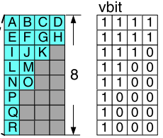
Obstacle 2: Vectorization
Second obstacle: inefficient vectorization
Invalid Computing
Zero-Padding
Xing Liu et.al. Efficient Sparse Matrix-vector Multiplication on x86-based Manycore Processors. (ICS ’13).
Notes:
Current solutions to the vectorization of SpMV is zero-padding
Padding zero elements in the matrix, and also need to set a mask matrix to guarantee the zero elements would not be reduced to the final result.
When the matrix gets larger, too much zero-elements would be padded. So that it introduces too much invalid computing.

Slide 13
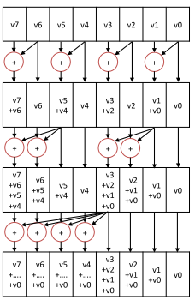
Obstacle 2: Vectorization
Second obstacle: inefficient vectorization
Invalid Computing
Zero-Padding
Complicated
Segmented sum
Weifeng Liu and Brian Vinter. CSR5: An Ecient Storage Format for Cross-Platform Sparse Matrix-Vector Multiplication. (ICS’15)

Slide 14
Obstacle 3: Extra Overhead
Iterative SpMV
Execution time of n iterations: ( n * T_{spmv} )
Pre-processing
Iterative SpMV
Execution time of n iterations: (T_{pre} + n * T_{new spmv})
The overhead need to be amortized with many iterations.
Notes:
Pre-processing (format conversion): blocking, sorting and etc.

Slide 15
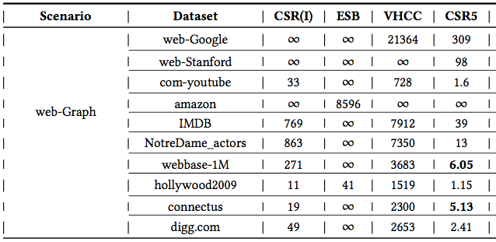
Obstacle 3: Extra Overhead
High overhead limits the practical application.
Could it be even lower?
Notes:
Eliminate the performance benifit

Slide 16
Motivation: Summary
Three factors impede creating an efficient SpMV multiplication kernel:
Poor cache locality
Inefficient vectorization
Extra pre-processing overhead

Slide 17
General idea of CVR
a |  | b |  | c | d
 |  | e | f
g |  |  |  | h |  | i | j
 |  | k
l |  |  | m |  | n
 |  | o | p
a | b | c | d
e | f
g | h | i | j
k
l | m | n
o | p
1
a | b | c | d
e | f
g | h | i | j
k
SIMD
lanes
2
3
4
Queue:
l | m | n
o | p

Slide 18
General idea of CVR
1
a
e
g
k
b
f
h
c
i
d
j
SIMD lanes
2
3
4
Queue:
l
m
n
o
p
one row per lane
multi-rows together
row by row

Slide 19
General idea of CVR
1
a
e
g
k
b
f
h
c
i
d
j
SIMD lanes
2
3
4
l
m
n
Queue:
o
p
one row per lane
multi-rows together
row by row

Slide 20
General idea of CVR
1
a
e
g
k
b
f
h
c
i
d
j
SIMD
2
o
p
0
1
2
3
SIMD lanes
3
4
l
m
n
a | e | g | k
b | f | h | l
c | o | i | m
d | p | j | n
CVR format
one row per lane
multi-rows together
row by row

Slide 21
SpMV with CVR
SIMD
1
2
3
4
Aligned memory references
Set a tmp buffer to store the intermediate data
matrix A
a | e | g | k
a | e | g | k
b | f | h | l
b | f | h | l
c | o | i | m
c | o | i | m
d | p | j | n
d | p | j | n
tmp buffer
vector y
Notes:
Write y[i] only once when all elements of row i in the original matrix have been finished

Slide 22
SpMV with CVR
SIMD
1
2
3
4
Aligned memory references
Set a tmp buffer to store the intermediate data
Write y[i] only once
matrix A
a | e | g | k
b | f | h | l
b | f | h | l
c | o | i | m
c | o | i | m
d | p | j | n
d | p | j | n
tmp buffer
vector y

Slide 23
SpMV with CVR
SIMD
1
2
3
4
Aligned memory references
Set a tmp buffer to store the intermediate data
Write y[i] only once
matrix A
a | e | g | k
b | f | h | l
c | o | i | m
c | o | i | m
d | p | j | n
d | p | j | n
tmp buffer
vector y

Slide 24
SpMV with CVR
SIMD
1
2
3
4
Aligned memory references
Set a tmp buffer to store the intermediate data
Write y[i] only once
SpMV is simplified through forward reduction
matrix A
a | e | g | k
b | f | h | l
c | o | i | m
d | p | j | n
d | p | j | n
tmp buffer
vector y

Slide 25
SpMV with CVR
SIMD
1
2
3
4
Aligned memory references
Set a tmp buffer to store the intermediate data
Write y[i] only once
SpMV is simplified through forward reduction
matrix A
a | e | g | k
b | f | h | l
c | o | i | m
d | p | j | n
tmp buffer
vector y

Slide 26
Experiments Setup
Knights Landing 7250
68 cores, 4 SMT per core, 34 MB L2 cache, AVX512
16G MCDRAM and 960G DDR4
30 scale-free sparse matrices
web-google, facebook, amazon, okut, IMDB, youtube …
28 HPC sparse matrices
protein, fullchip, wind tunnel, FEM/*, Rucci1, ldoor ...
Formats for Comparison
MKL(CSR), CSR-I, ESB (ICS’13), VHCC (CGO’15), CSR5 (ICS’15)
1000 runs for average

Slide 27
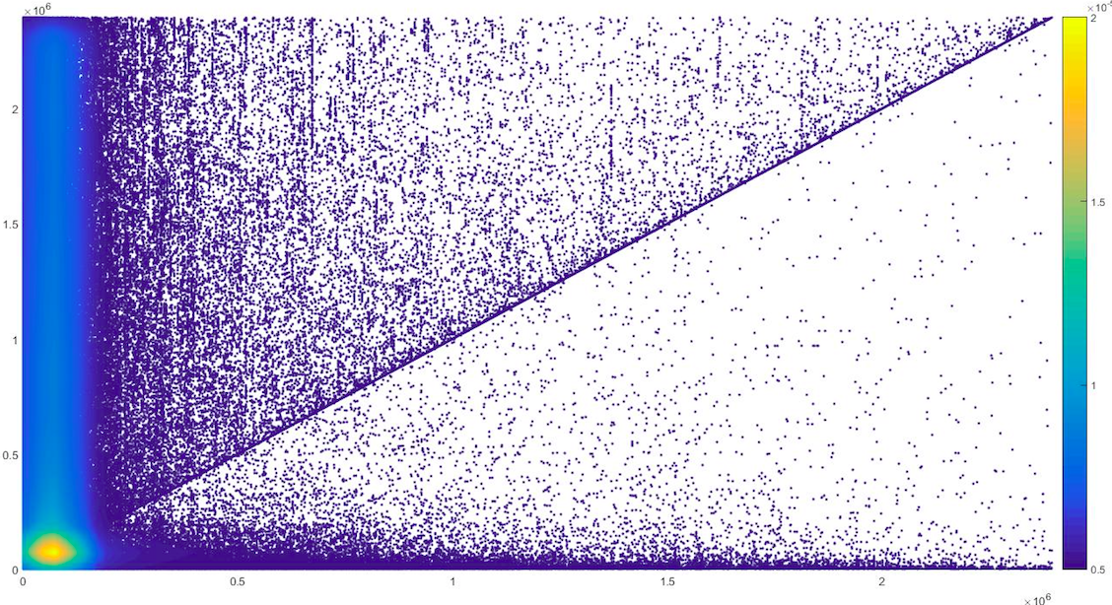
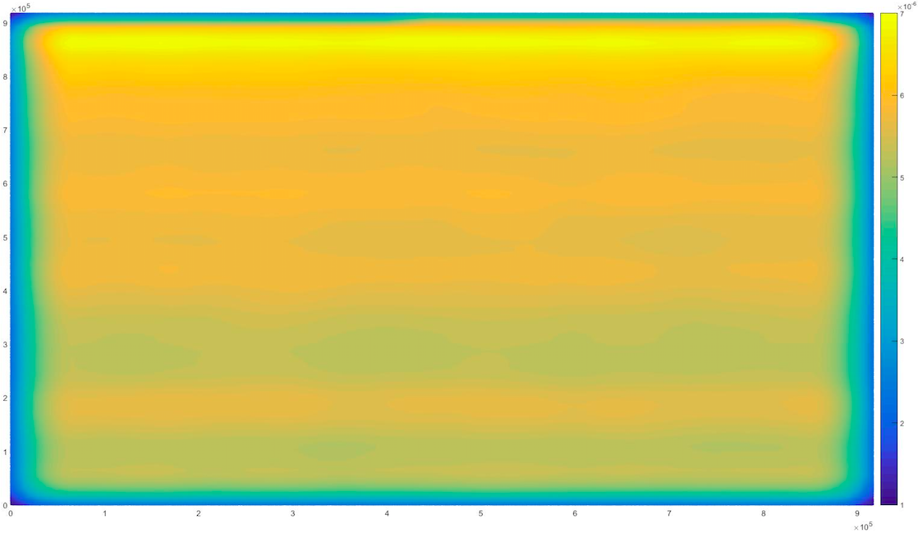
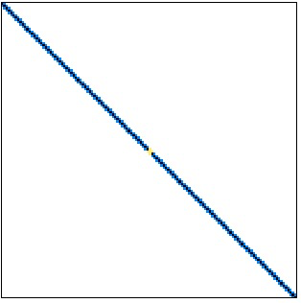
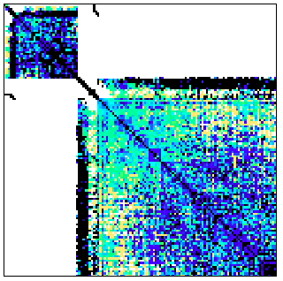
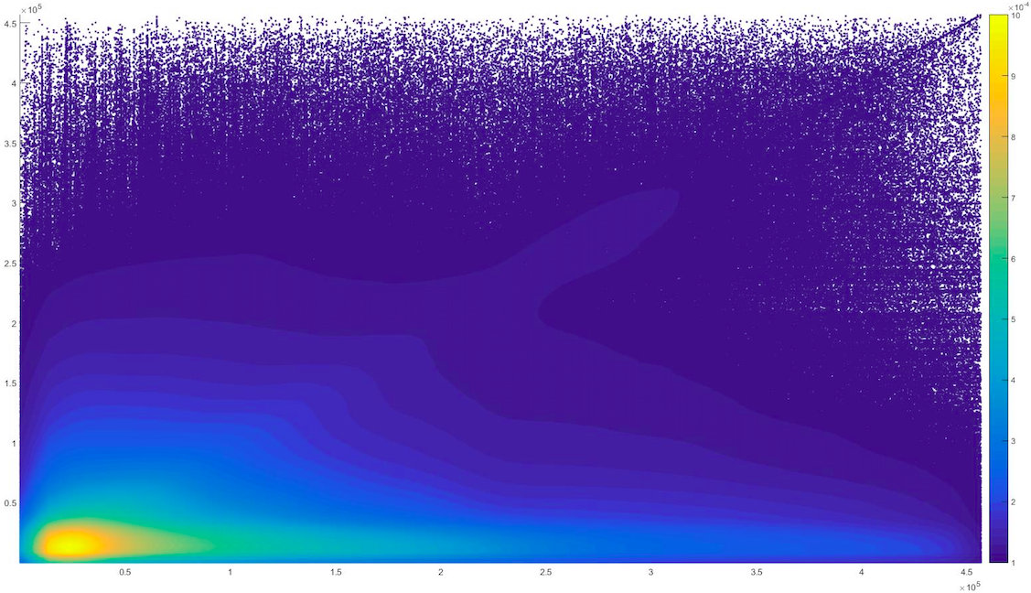
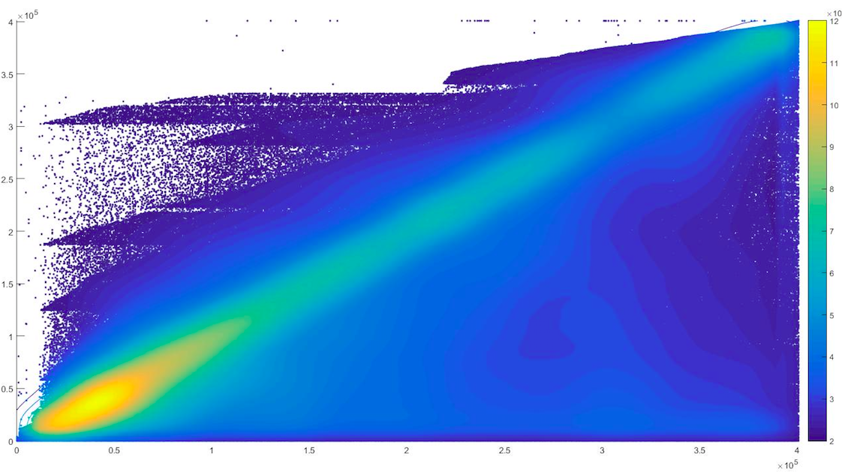
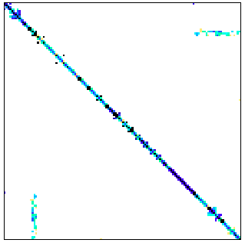
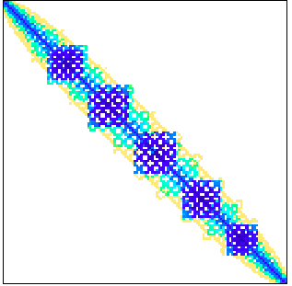
Sparse patterns
Scale-Free
HPC
FEM/Cantilever
Economics
Wikipedia -Talk
Web-Google
ASIC-100k
Wind Tunnel
Ga41As41H72
higgs-Twitter
Amazon-0312

Slide 28
SpMV performance
Compare to MKL
Scale-free: average 2.84x, up to 40x for HPC average 1.22x, up to 17x
Compare to the second best (CSR5)
Scale-free, average 1.33x, up to 1.7x; for HPC, average 1.10x, up to 1.57x

Slide 29
Cache Locality
A magnitude lower L2 cache miss ratio

Slide 30
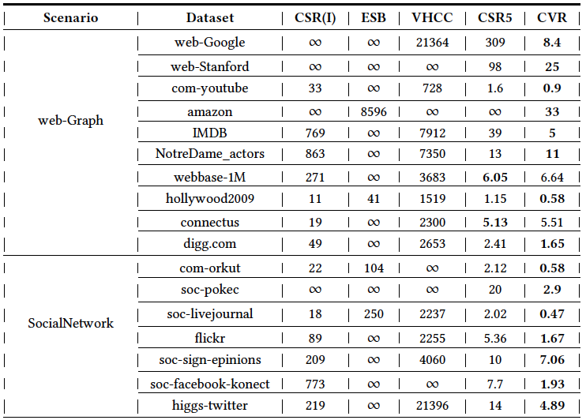
Overhead
: number of iterations that are needed
to amortize the overhead
: Pre-processing time of converting a matrix
to a new format
: SpMV time using MKL routine
: SpMV time using the new format
The least overhead on 90% scale free datasets and 70% HPC datasets

Slide 31
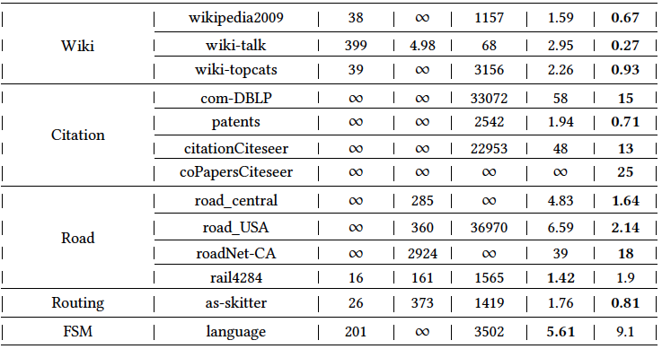
Overhead
: number of iterations that are needed
to amortize the overhead
: Pre-processing time of converting a matrix
to a new format
: SpMV time using MKL routine
: SpMV time using the new format
The least overhead on 90% scale free datasets and 70% HPC datasets

Slide 32
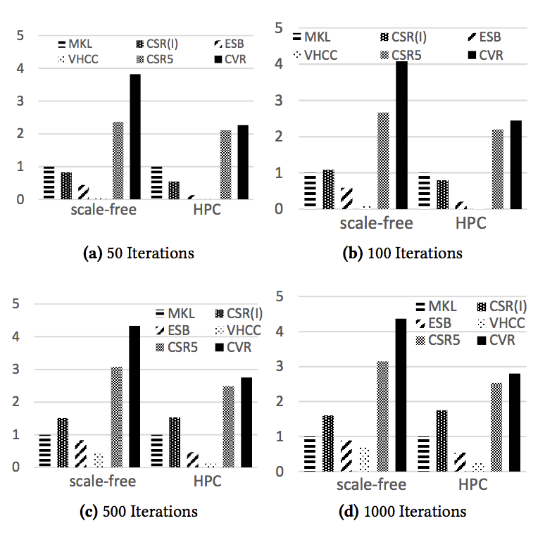
Overall performance
: The overall performance
speedup over MKL
: Number of iterations
: Pre-processing time of converting
a matrix to a new format
: SpMV time using MKL routine
: SpMV time using the new format
Over MKL: 4.2x on scale-free matrices
2.8x on HPC matrices
Over CSR5: 1.3x on scale-free matrices
1.1x on HPC matrices

Slide 33
Conclusion
CVR: a new format for SpMV on X86 processors
Better locality and vectorization
Lower pre-processing overhead
Source code
Passed artifact evaluation
https://prof.ict.ac.cn/CVR.html (ready by next week)
Codes available on https://www.github.com/puckbee/CVR

Slide 34
Q&A

Slide 35
Slides for Defending

Slide 36
Vetorization
c [0:8] += a [0:8] + b [0:8]
a1 | a2 | a3 | a4 | a5 | a6 | a7 | a8
b1 | b2 | b3 | b4 | b5 | b6 | b7 | b8
b1 | b2 | b3 | b4 | b5 | b6 | b7 | b8
SIMD Reg
a1 | a2 | a3 | a4 | a5 | a6 | a7 | a8
avx512, avx2, avx
CUDA, OpenCL
NEON on ARM
DSP & FPGA …
Mem

Slide 37
Memory Reference
SIMD Reg
a1 | a2 | a3 | a4 | a5 | a6 | a7 | a8
Gather and Scatter
Mem
SIMD Reg
a1 | a2 | a3 | a4 | a5 | a6 | a7 | a8
Write Confliction
Mem

Slide 38
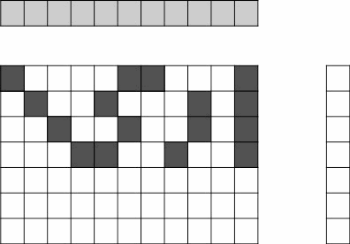
General idea of CVR

Slide 39
General idea of CVR

Slide 40
General idea of CVR
Memory references of CSR and CSR5
Memory references of CVR

Slide 41
Design of CVR

Slide 42
SpMV of CVR

Slide 43
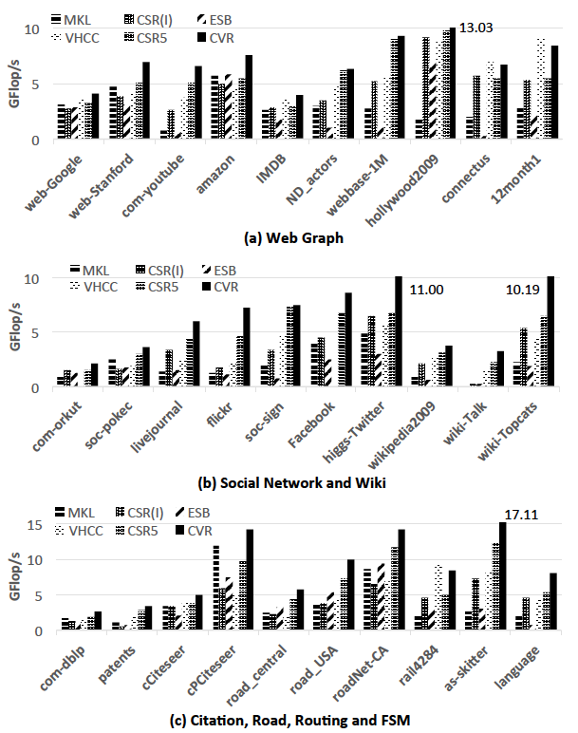
SpMV performance
Compare to MKL
Scale-free: average 2.84x, up to 40x
HPC: average 1.22x, up to 17x
Compare to the second best (CSR5)
Scale-free: average 1.33x, up to 1.7x
HPC: average 1.10x, up to 1.57x
Please refer to our paper for the results of HPC data sets.

Slide 44
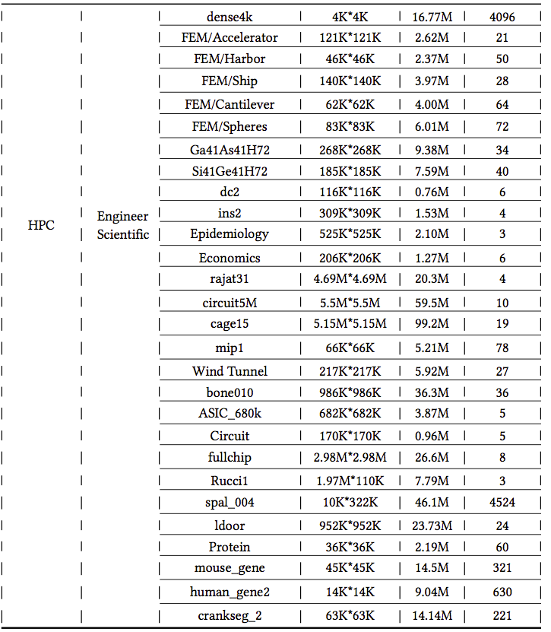
Scale-Free
HPC
Notes:
最大的矩阵

Slide 45
General idea of CVR
vector x
vector x
Matrix A
vector y
Matrix A
vector y
CSR, CSR5
Processing data row by row
CVR
Processing multiple rows together

Slide 46
SpMV performance

Slide 47
Vetorization
a1 | a2 | a3 | a4 | a5 | a6 | a7 | a8
Load & Store
aligned
avx512, avx2, avx, sse
CUDA, OpenCL
NEON on ARM
DSP & FPGA …

Slide 48
Vetorization
a1 | a2 | a3 | a4 | a5 | a6 | a7 | a8
aligned
Gather & Scatter

Slide 49
Obstacle 2: Vectorization
a [ ] =
a0 | a1 | a2 | a3 | a4 | a5 | a6 | a7
x [ ] =
x0 | x3 | x4 | x2 | x6 | x1 | x3 | x7
c [ ] =
c0 | c1 | c2 | c3 | c4 | c5 | c6 | c7
y [ ] =

Slide 50
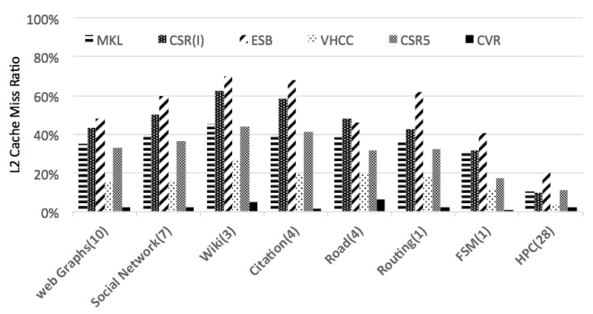
Introduction
First obstacle: inefficient cache utilization

Slide 51
Existing work
Formats | padding | Sorting | Partitioning | Overhead | Performance
MKL (Intel) | N | N | N | N | Poor
ELLPACK (Intel) | Y | N | Y | High | Poor
ESB (ICS’13) | Y | Y | Y | High | Poor
VHCC (CGO’15) | N | Y | Y | High | Mid
CSR5 (ICS’15) | N | N | Y | Low | Mid
IRRG(CGO’16) | Y | Y | Y | Very High | Poor
CVR | N | N | N | Low | Good

Slide 52
SpMV performance

Slide 53
Introduction
Third obstacle: High pre-processing overhead
Partition
Blocking
Re-ordering
Sorting
Expensive

Slide 54
SpMV-PageRank
new_rank[ ] = adjacent_matrix • rank[ ]
adjacent matrix
rank[]
new rank[ ]
=

Slide 55
Motivation
Is existing work good enough?

Slide 56
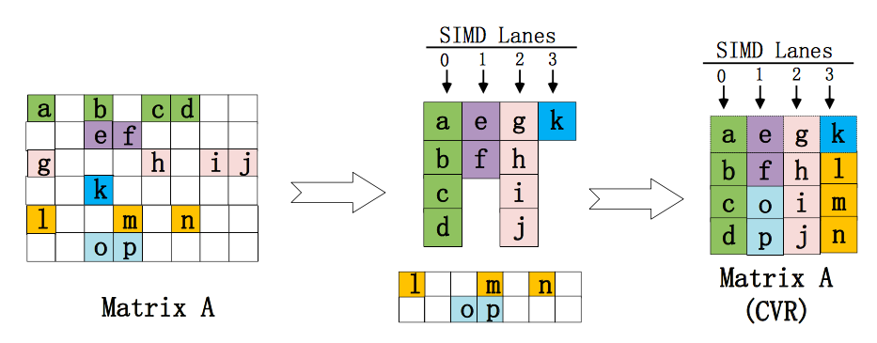
General idea of CVR
one row per lane
multi-rows together
row by row

Slide 57
Experiments Setting
Data Sets
30 scale-free sparse matrices
web-google, facebook, amazon, okut, IMDB, youtube …
28 HPC sparse matrices
protein, fullchip, wind tunnel, FEM/*, Rucci1, ldoor ...
Formats for Comparison
MKL(CSR), CSR-I
ESB (ICS’13)
VHCC (CGO’15)
CSR5 (ICS’15)

Slide 58
Experiments: Summary
SpMV performance
Compare to MKL
Scale-free: average 2.84x, up to 40x
HPC: average 1.22x, up to 1.7x
Cache Locality
a magnitude lower L2 cache miss ratio
Pre-processing overhead
Scale-free: 90% the least overhead
HPC: 70% the least overhead

Slide 59
Notes:
最大的矩阵

Slide 60
Motivation
Formats for Comparison
CSR (MKL)
CSR-I (Intel)
ESB (ICS’13)
VHCC (CGO’15)
CSR5 (ICS’15)

Slide 61
Motivation
Scale-free matrices have much lower GFlop/s

Slide 62
Obstacle 2: Vectorization
0 | 1 | 2 | 3 | 4 | 5 | 6 | 7
x0
x1
x2
x3
x4
x5
x6
x7
a0 |  |  | a1 | a2
 |  | a3 |  |  |  | a4
 | a5 |  | a6 |  |  |  | a7
a8 |  |  |  | a9 | a10
y0
y1
y2
y3
=
a [ ] =
a0 | a1 | a2 | a3 | a4 | a5 | a6 | a7
x’ [ ] =
x0 | x3 | x4 | x2 | x6 | x1 | x3 | x7
y [ ] =
y0 | y1 | y2 | y3

Slide 63
Obstacle 2: Vectorization
a [ ] =
a0 | a1 | a2 | a3 | a4 | a5 | a6 | a7
x’ [ ] =
x0 | x3 | x4 | x2 | x6 | x1 | x3 | x7
c [ ] =
c0 | c1 | c2 | c3 | c4 | c5 | c6 | c7
y [ ] =
y0 | y1 | y2 | y3
Conflict

Slide 64
Obstacle 3: Overhead
SpMV Time
SpMV Time
SpMV Time
Pre-processing Time
New SpMV Time
Format Conversion
Pre-processing Time
Iterative SpMV
Amortize the overhead with multiple iterations.

Slide 65
Solution to Obstacle 1 and Obstacle 2:
Reordering the non-zero elements
Reordering Columns
Reordering Rows
Partitioning / Blocking

Slide 66
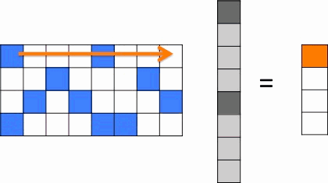
Obstacle 1: Cache Locality
Given a sparse m×n matrix A and an n×1 input vector x. We consider both sequential and parallel computation of
y = A • x:

Slide 67
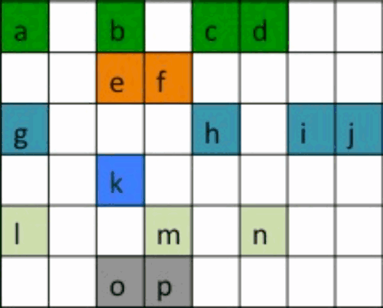
a |  | b |  | c | d
 |  | e | f
g |  |  |  | h |  | i | j
 |  | k
l |  |  | m |  | n
 |  | o | p
1
a | b | c | d
e | f
g | h | i | j
k
a | b | c | d
e | f
g | h | i | j
k
l | m | n
o | p
SIMD
lanes
2
3
4
l | m | n
o | p

Slide 68
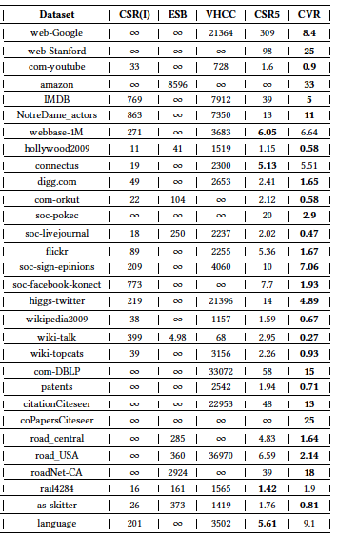
Overhead
: number of iterations that are needed
to amortize the overhead
: Pre-processing time of converting a matrix
to a new format
: SpMV time using MKL routine
: SpMV time using the new format
The least overhead on 90% scale free datasets
The least overhead on 70% HPC datasets

Slide 69
General idea of CVR
1
SIMD lanes
2
3
Reduction to
vector y
4
Improve cache reutilization
Better Vectorization

Slide 70
Experiments Setup
Knights Landing 7250
68 cores, 4 SMT per core, 34 MB L2 cache, AVX512
16G MCDRAM and 960G DDR4
30 scale-free sparse matrices
web-google, facebook, amazon, okut, IMDB, youtube …
28 HPC sparse matrices
protein, fullchip, wind tunnel, FEM/*, Rucci1, ldoor ...
Formats for Comparison
MKL(CSR), CSR-I, ESB (ICS’13), VHCC (CGO’15), CSR5 (ICS’15)
1000 runs for average

Slide 71
SpMV performance
Scale-free matrices (30)
Over MKL: up to 40x, average 2.84x
Over the second best(CSR5): up to 1.7x, average 1.33x
HPC matrices (28)
Over MKL: up to 17x, average 1.22x
Over the second best(CSR5): up to 1.57x, average 1.10x

